Slide 1
CAPSTONE PROJECT-I
DATA EXPERIMENTATION CAPSTONE
By Siva Turac, 07/29/2022

Slide 2
CONTENT
Part I-Data
Part II-Data Science Approach
Data Wrangling/Data Cleaning
EDA-exploring the data
Modelling-A/B testing
Interpretation
Various Plots regarding EDA-exploring the data
Our aim is to investigate if new campaign provides enough benefits, i.e. the higher conversion rate of a company. To do so, we use A/B Test method.
JupiterNotebooklink:
http://localhost:8888/notebooks/SIVATURACPROJECT1.ipynb#
Githublink:
https://github.com/songulclk/string/blob/3406c67a29ddc5521d78575e8c98a93491a7c25d/SIVATURACPROJECT1.ipynb.json

Slide 3
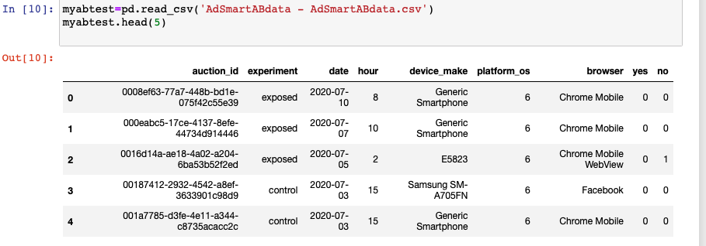
Part I-Data
I downloaded the data from Kaggle.com and follow the ‘Sample Distribution Method for A/B testing’ method provided on that page.
Here we can see first 5 rows of the data, renamed as ‘myabtest’

Slide 4
Columns Details
VariableName | Description
auction_id | the unique id of the online user who has been presented the BIO. In standard terminologies this is called an impression id. The user may see the BIO questionnaire but choose not to respond. In that case both the yes and no columns are zero.
experiment | which group the user belongs to - control or exposed. Control: users who have been shown a dummy ad. Exposed: users who have been shown a creative, an online interactive ad, with the SmartAd brand.
date | the date in YYYY-MM-DD format
hour | the hour of the day in HH format
device_make | the name of the type of device the user has e.g. Samsung
platform_os | the id of the OS the user has.
browser | the name of the browser the user uses to see the BIO questionnaire.
yes | 1 if the user chooses the “Yes” radio button for the BIO questionnaire.
no | 1 if the user chooses the “No” radio button for the BIO questionnaire.

Slide 5
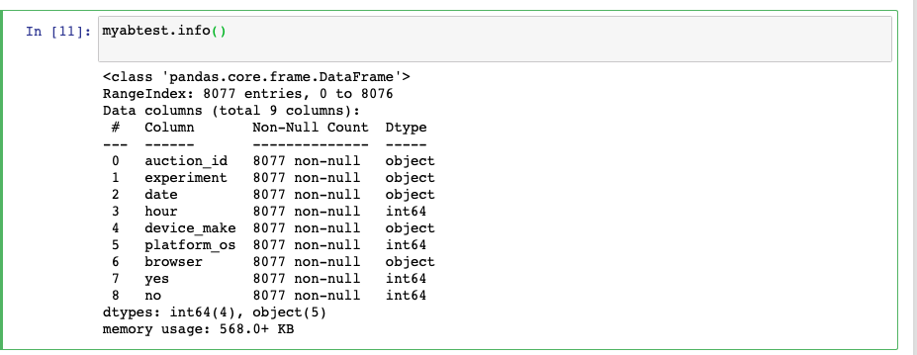
Part II-Data Science Approach Data Wrangling/ Data Cleaning Exploring the Data
As we can see, there is no null values in any columns.

Slide 6
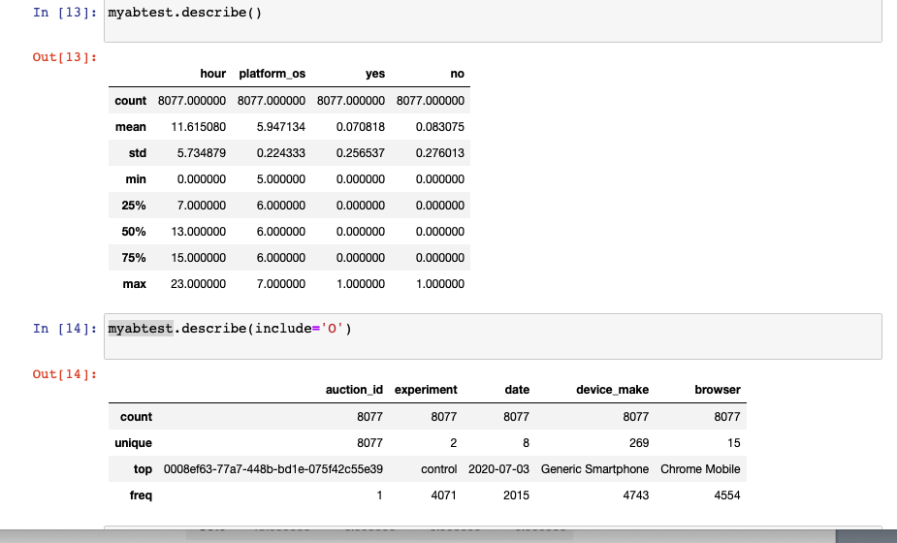
‘Describe’: To see summary statistics

Slide 7
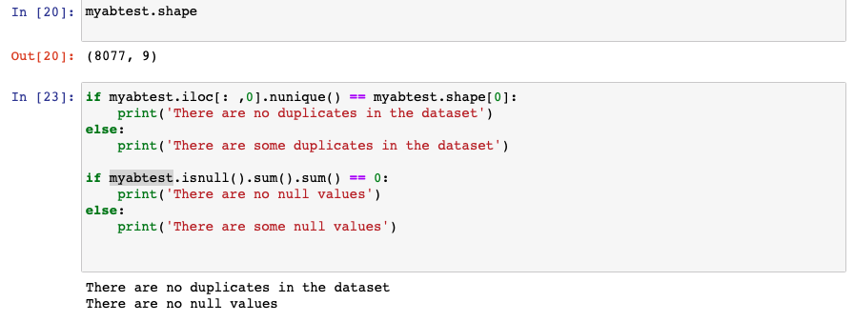
To check null values and duplicates, I use the following code:

Slide 8
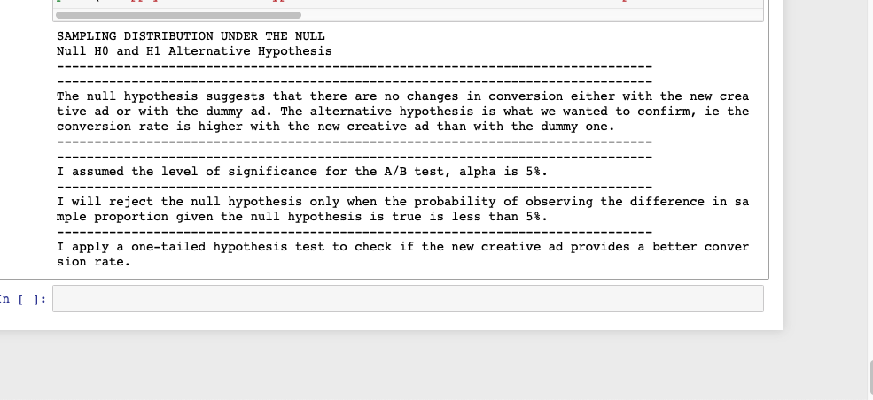
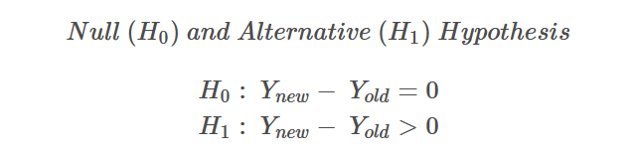
Modelling-A/B testing Sampling distribution under the null

Slide 9
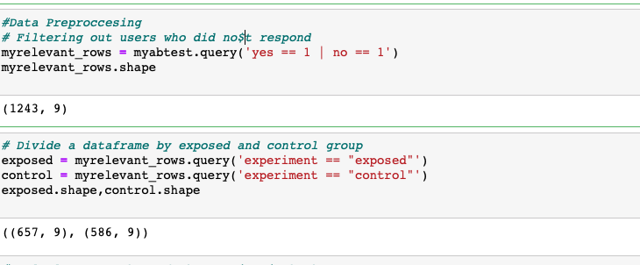
Step1-Filtering out the impressions where users neither clicked the yes nor the no button and then obtaining ‘relevant rows’ Step2-Divide the dataframe, ’myrelevant_rows’, by exposed and control group

Slide 10
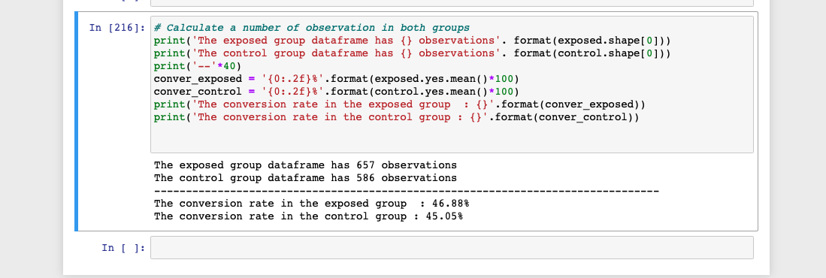
Step3-Calculate number of observations in both groups Step4-Calculate the conversion rates(‘conver_exposed’, ‘conver_control’)

Slide 11
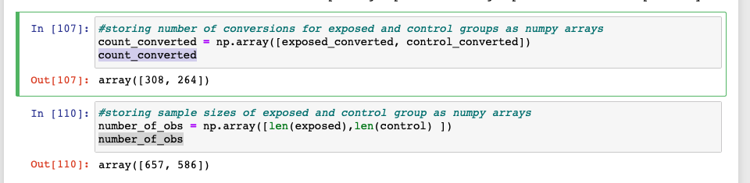
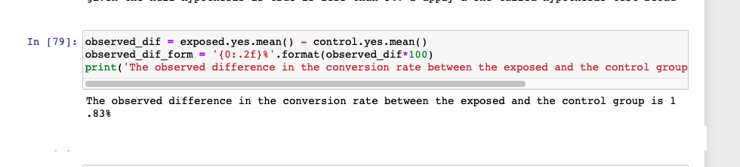
Step5-Calculating the sample sizes and the number of conversions in control and exposed groups. Then storing them as numpy array Step6-Calculate observed difference in the conversion rates

Slide 12
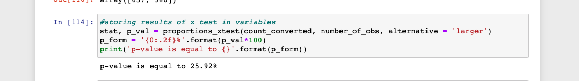
Step7-Calculating p-value
Propotions_ztest
Since p-value>alpha,(0.2592>0.05), we fail to reject the H0, the null hypothesis.
No changes in conversion either with the new add or with the dummy add

Slide 13
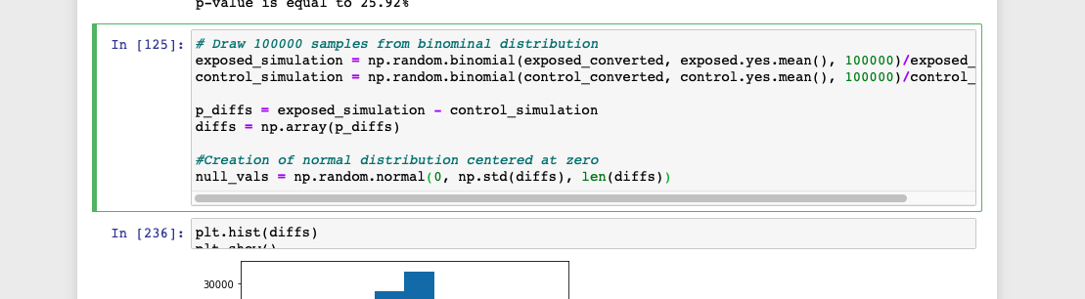
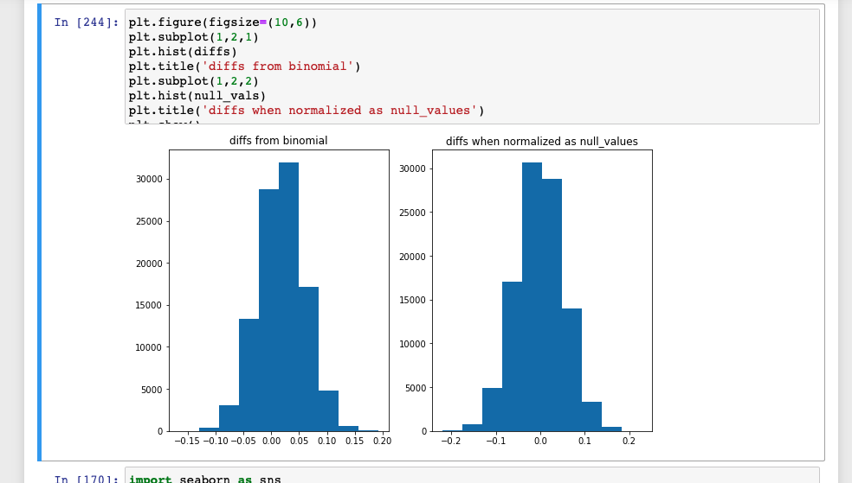
Step8- Drawing 10000 samples from binomial distribution and center around 0:

Slide 14
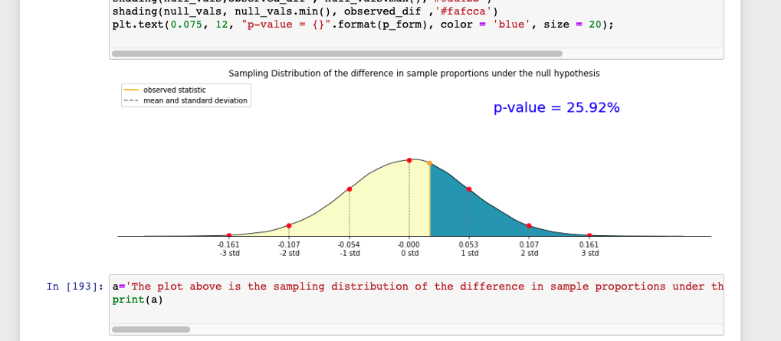
The plot of the sampling distribution of the difference in sample proportions under the null hypothesis.
The observed difference in conversion rates falls between the mean and the first standard deviation.
The area shaded in blue starts with the observed difference in conversion rate and goes up to the right end,
which represents differences more extreme than the observed.
The probability that the observed difference falls into the sampling distribution of the null hypothesis is equal to 25.92%.
Given that our level of significance is 5%, we fail to reject the null hypothesis.
Not enough evidence to conclude that the conversion rate with the new creative ad is higher than with the dummy one.

Slide 15
Answers to the Problem Question
Does the new ad generate more responses to their questionnaire?
There exists not enough evidence to prove that new ad had a positive effect on the responses.
Is it statistically significant?
According to the result we get , this is insignificant.
Is the company justified in using the new ad?
Taking the results into account, we can not say that the company can justify the
utilization of the new ad.

Slide 16
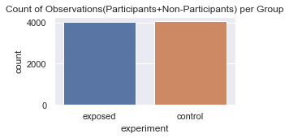
PLOTS(EDA) Plot1-Count of Observations(Participants+Non-Participants) per Group

Slide 17
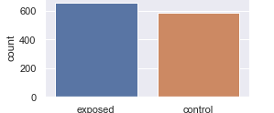
Plot2-Count of Observations of Participants -per Group-

Slide 18
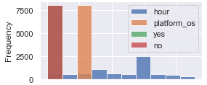
Plot3-Histogram of Numeric Variables

Slide 19
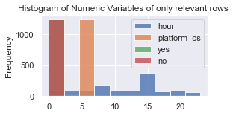
Plot4:

Slide 20
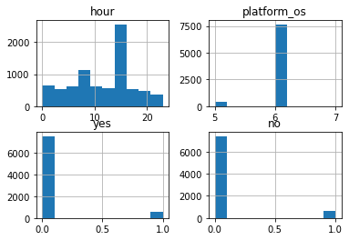
Plot5- Histogram of numeric columns

Slide 21
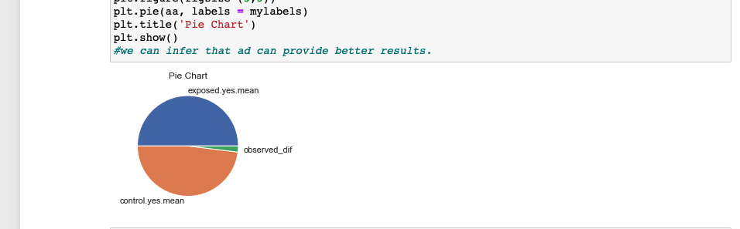
Plot6-Pie Chart

Slide 22
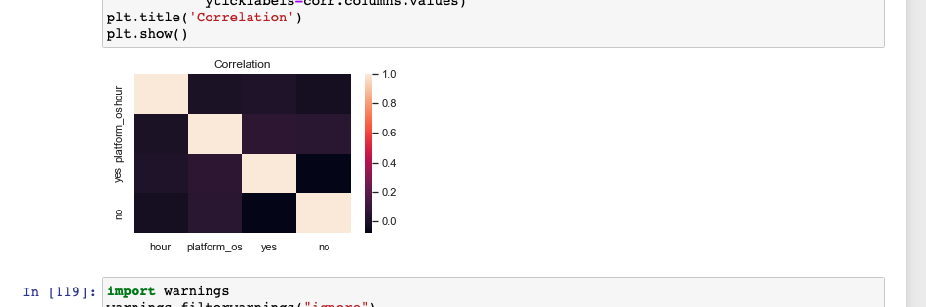
Plot7- Correlation of Numeric Columns

Slide 23
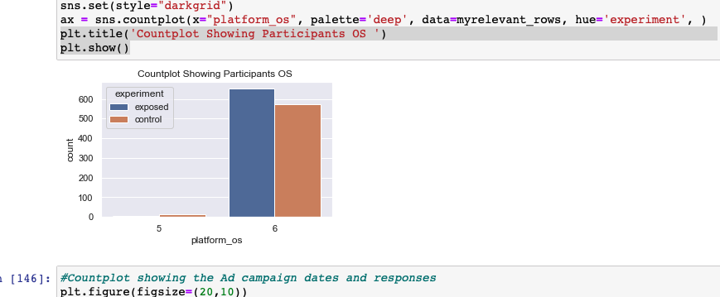
Plot8-Countplot Showing Participants’ OS

Slide 24
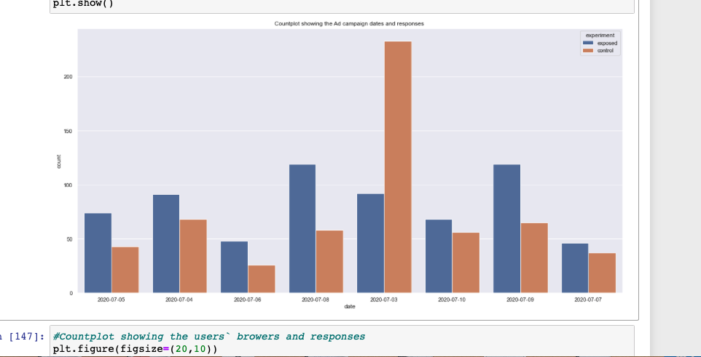
Plot9-Countplot showing the Ad campaign dates and responses

Slide 25
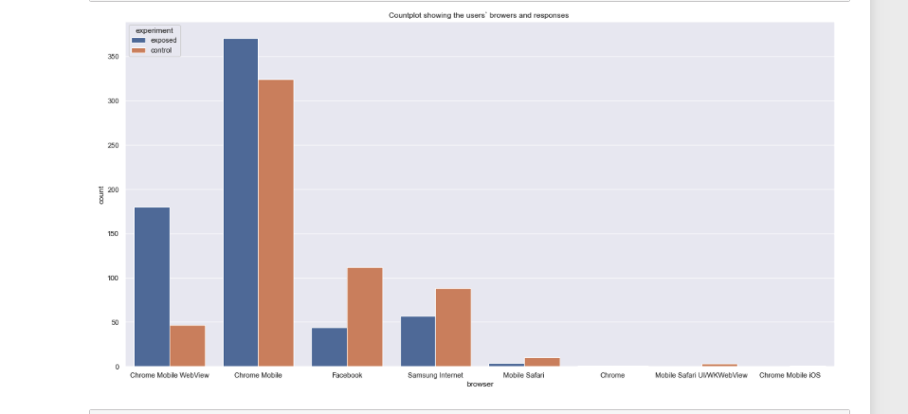
Plot10-Countplot showing the users` browsers and responses

